Slide 1
Impact of the Covid-19 pandemic on provision of acute care in Scotland.
Emma, Justyna, Tom, Louise

Slide 2
Team
Emma
Justyna
Louise
Tom

Slide 3
Summary
Introduce the Team
Project brief and our Approach
KPIs
Dashboard
Key findings

Slide 4

Project Brief
To what extent are the ‘winter crises’ reported by the media real?
2. How has the Covid-19 pandemic affected provision of acute care in Scotland?
Temporal: How has this issue changed over time? (Is it getting better or worse?)
Geographic: How does this issue differ between areas in Scotland? (Where should efforts be focussed?)
Demographic: Who is most affected by this issue? (Who should be targeted with efforts?)

Slide 5

Data
Hospital Activity by Speciality
Hospital Activity and Patient Demographics
Hospital Activity and Deprivation
Hospitalisations due to Covid 19
A&E attendances and performance data
Quarterly Hospital Beds Information - Datasets - Scottish Health and Social Care Open Data - nhs.scot
Delayed discharge data

Slide 6

The way to get started is to quit talking and begin doing.
Walt Disney

Slide 7




Project Timeline
FRIDAY
Familiarisation with the project brief, Trello set up, agreeing team rules for smooth progress and timeframe for the project, tasks division for the weekend.
1
MONDAY
Feedback the key findings from the assigned reports to the rest of the team, start the work on the wire frame and GitHub repo creation.
2
TUESDAY
Work on individual plots and create UI and server inputs for them.
3
WEDNESDAY
Put the individual plots together to create a dashboard. Testing, unifying and debugging
4
THURSDAY
Project review, report writing, presentation prep and tidying up Git repo.
5

Slide 8

Key Performance Indicators
Hospital Admissions
Length of hospital stay
Hospital beds availability

Slide 9
Dashboard

Slide 10
How has the Covid-19 pandemic affected provision of acute care in Scotland?
To what extent are the ‘winter crises’ reported by the media real?

Slide 11
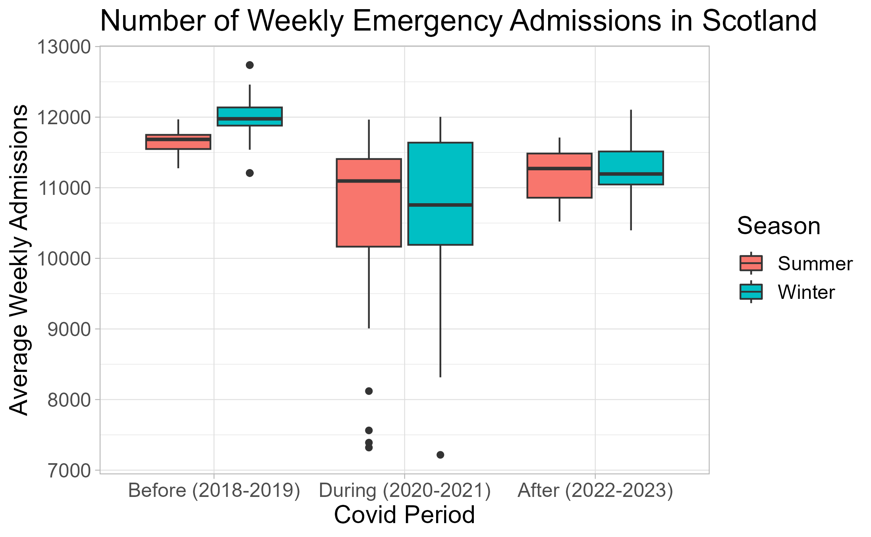
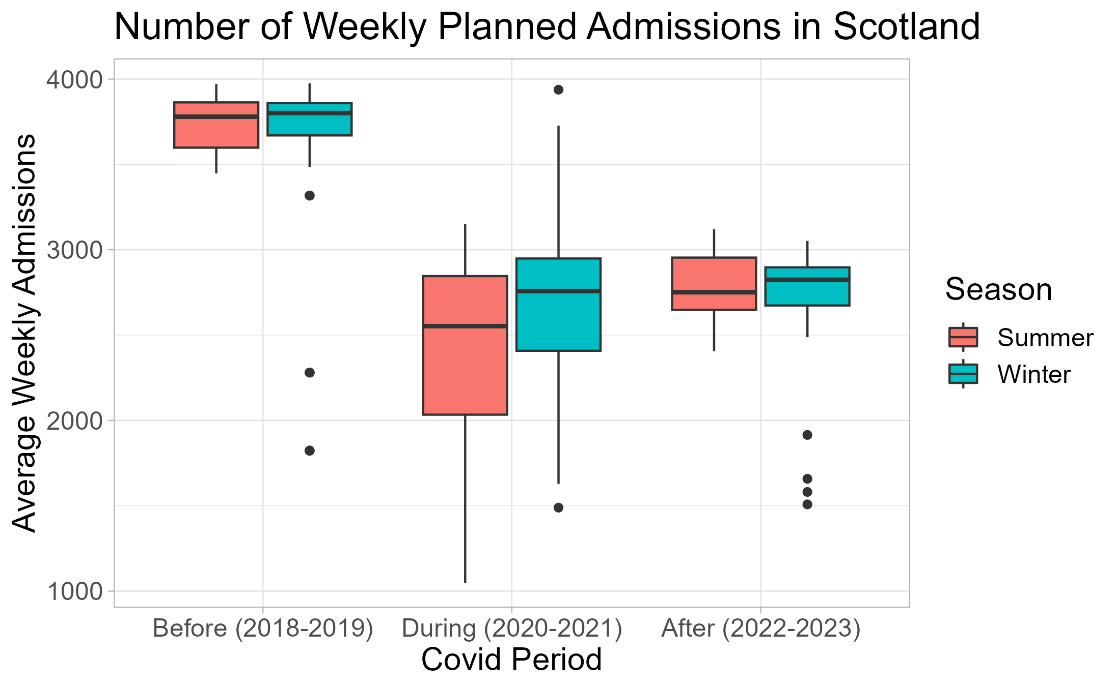
Number of Admissions

Slide 12
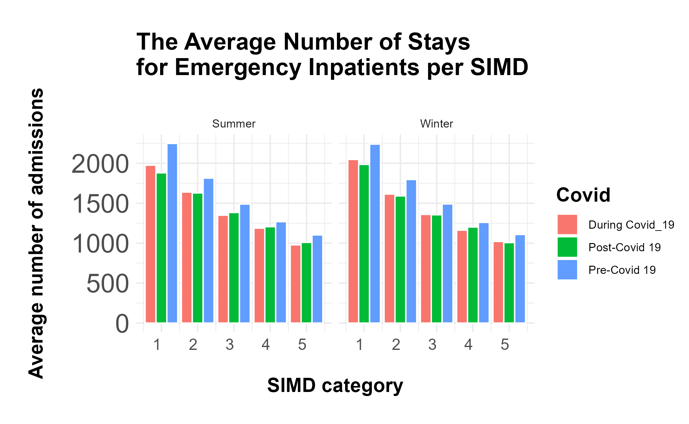
Notes:
Scottish Index of Multiple Deprivation

Slide 13
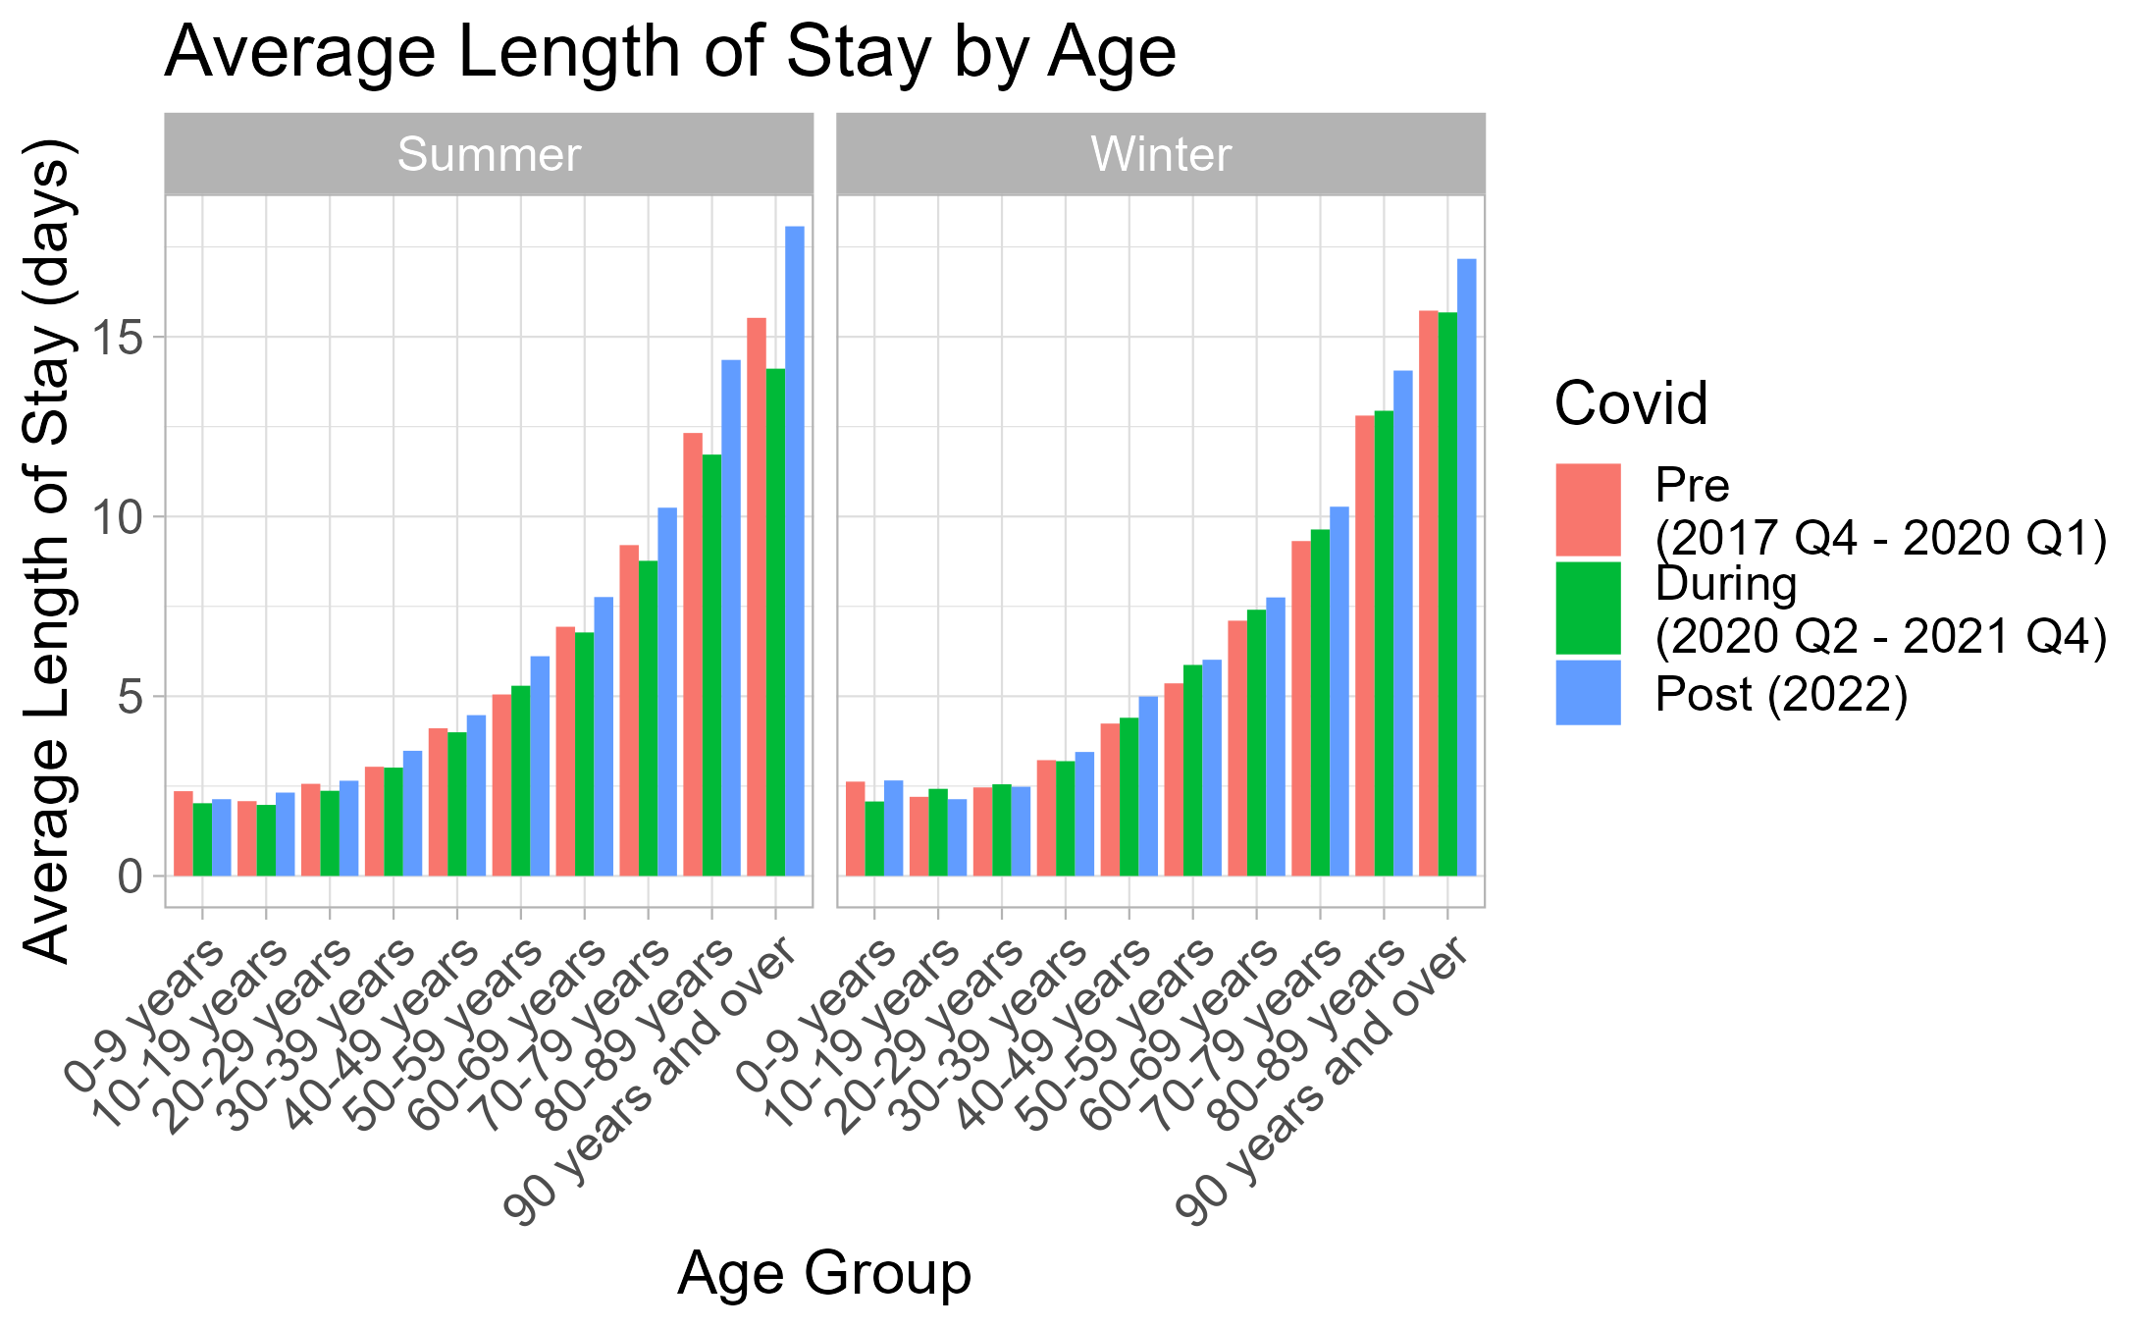
Length of Stay for Emergency Inpatients

Slide 14
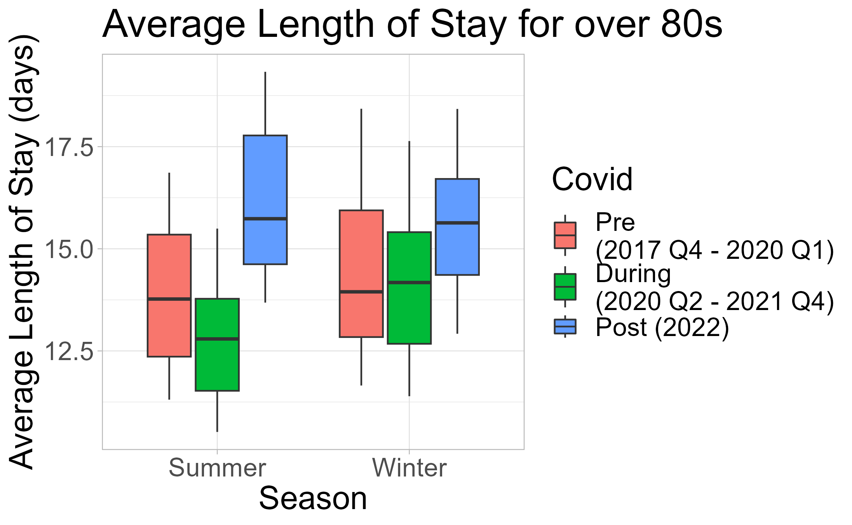

Slide 15
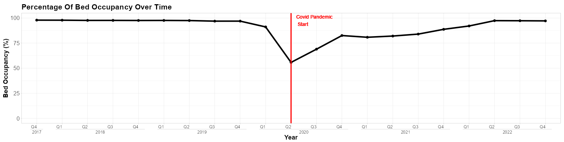
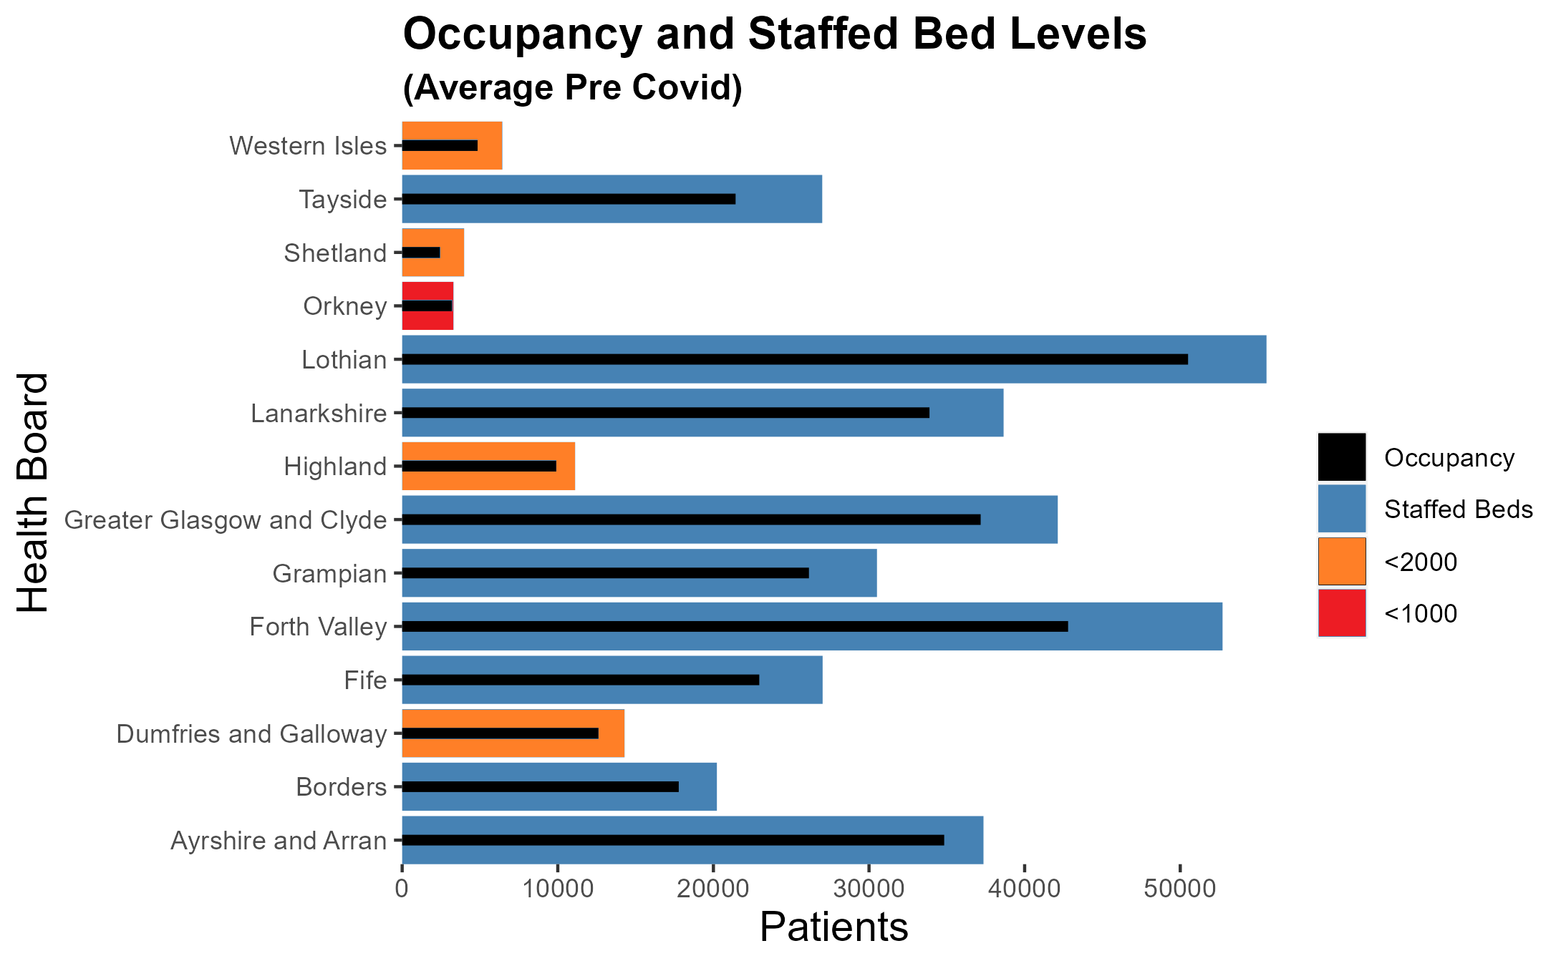
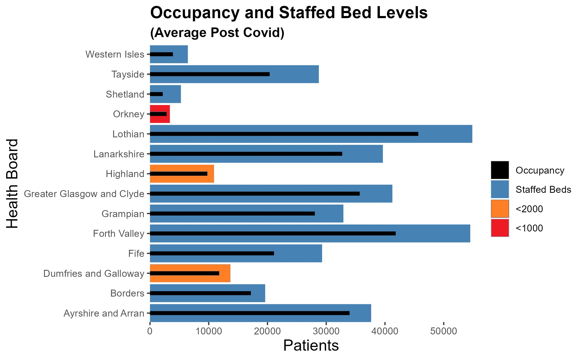
Bed Availability

Slide 17
What is Driving the Improvement?
Exceeding recruitment commitments
- April 2022 £4.5 million funding recruitment package.
- Recurring Scottish Government funding of £1 million targeted at overseas recruitment.
- Exceeded commitment to recruit additional health workers in key settings.
Improved staff conditions
- Invested £12 million to support well-being and further investment is planned.
- Invested in staff, through fair pay, increased training and upskilling opportunities.
Increased investment in training existing and new staff
- Introduced a number of new bursaries to widen access to careers in health and care.
- Established the NHS Scotland Academy which provides a broad range training opportunities
- Committed to increase medical undergraduates by 500 places

